Slide 1
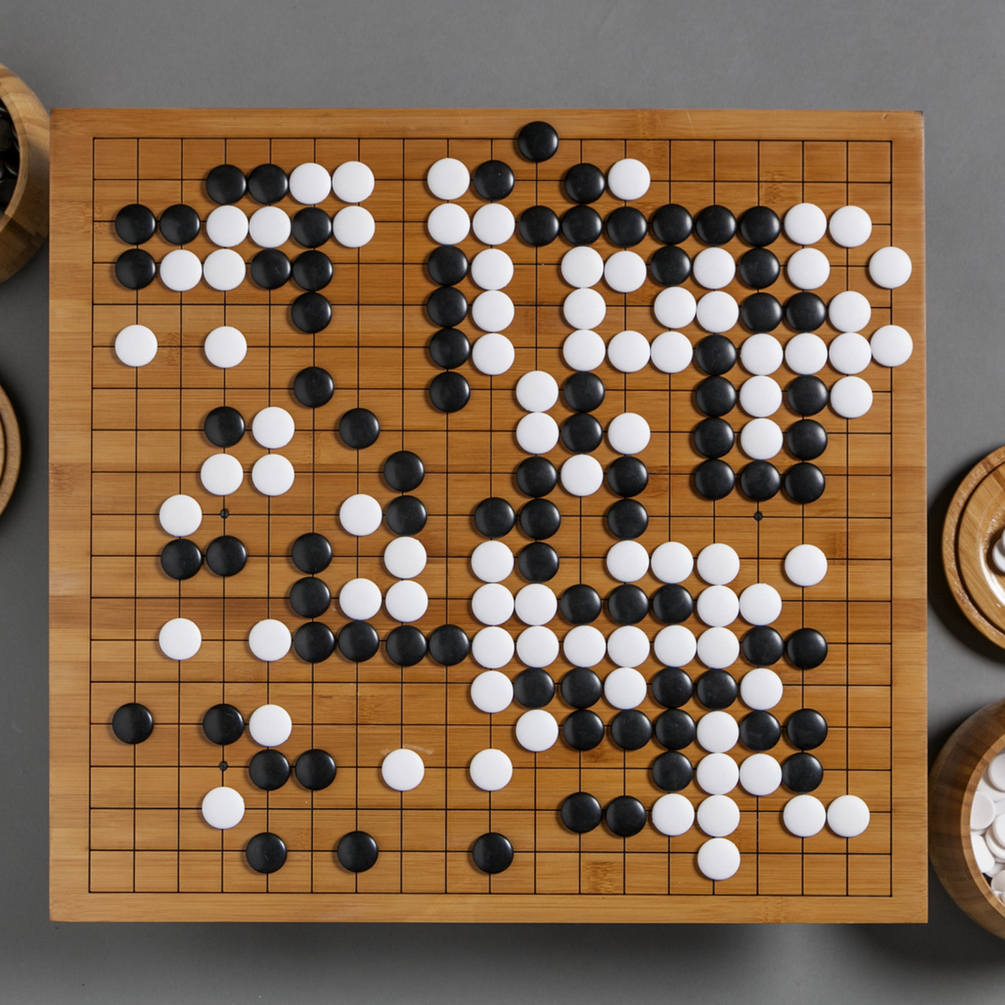
CSCI 599: ZeroGo
Solving the game of Go with ML
Sunny Patel
Jing Ouyang
Wesam Alwehaibi

Slide 2
What we did last week?
Code side:
Exploring Heuristics (IP)
Training the policy agent (IP)
Training the value agent (Done)
Improving the AlphaGo MCTS agent (Done)
Doc side:
Start to build the webpage

Slide 3
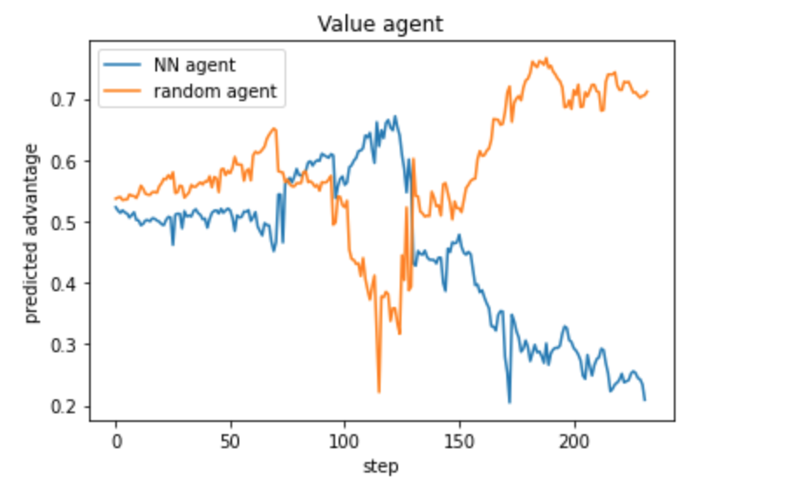
What we did last week?
Exploring Heuristics
Heuristics -- on top of agents and training
Integrated Greedy heuristic to select moves indicated by MCTS.
Worsens the move.

Slide 4
What we did last week?
Training the policy agent using RL
Conducted trials to figure the average number of games needed to improve agent
Influenced by many params: game quality, learning rate, batch size
Used Binomial test to measure significant agent improvements
Self-play games might not be all of good quality -- large batch size could be better
Code improvements to accommodate computational restrictions in colab

Slide 5
What we did last week?
Training the policy agent
Currently the agent is in an infinite loop of:
Agent showed first signs of improvement after 1800 self-play games (200 self-play games at each iteration, with batch size 2048)
Step 1
Generate self-play games
Step 4
Step 2
Update the agent if improvement occurs
Train the agent using generated games
Step 3
Evaluate the Agent against previous version

Slide 6
What we did last week?
Training the value agent
Value agent: judge the board position
Version 1:
Reward 1 for win, -1 for lose for every step
Version 2:
Discount the reward for early game
Reward 0 for the first 30 steps, with linear discounted reward after that until the full reward in the late game (>150 steps)
Version 3:
More rewards on rewards for early game
Reward 0 for the first 30 steps, with quadratic discounted reward after that until the full reward in the late game (>270 steps)
Integrate the board scoring for that state

Slide 7
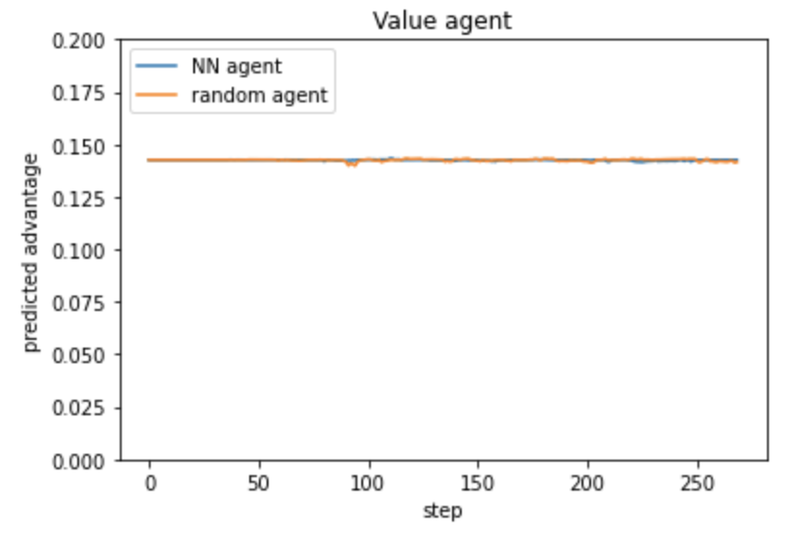
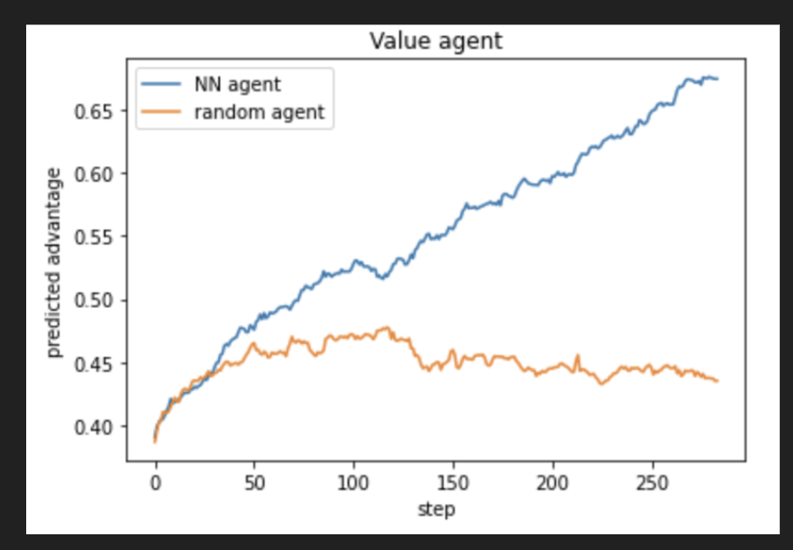
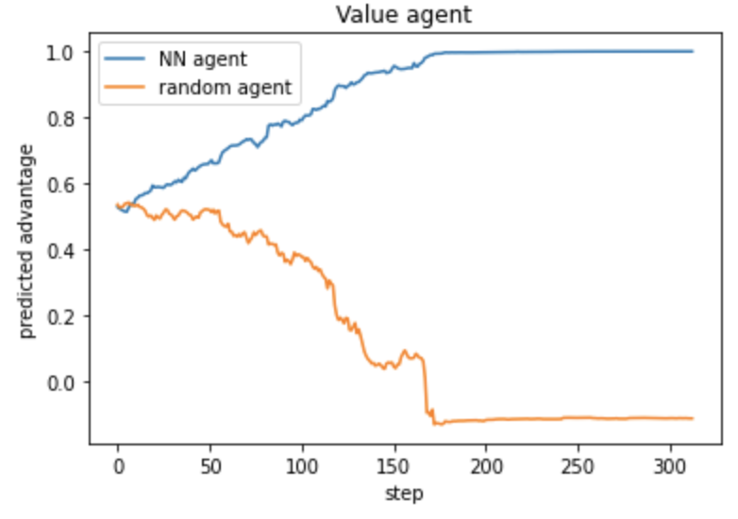
What we did last week?
Naive reward
Discounted reward
Rectified reward

Slide 8
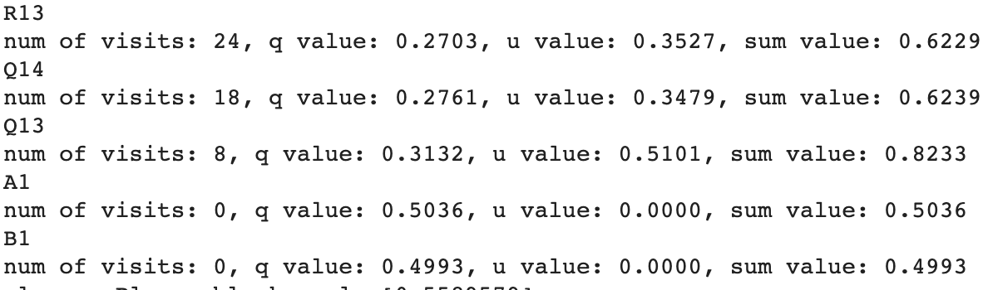
What we did last week?
Improving the AlphaGo MCTS agent
AlphaGo = policy agent + value agent + MCTS rollouts
Policy agent: u value (instincts)
Value agent + rollouts: q value (search results)
MCTS: select a branch using u value + q value

Slide 9
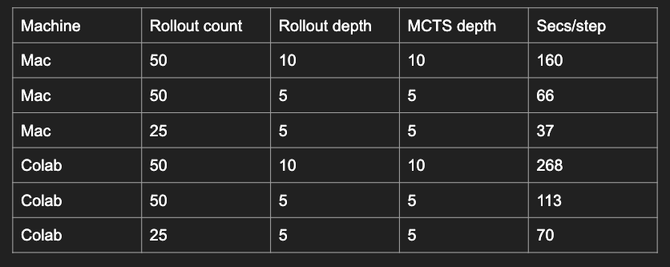
What we did last week?
Improving the AlphaGo MCTS agent
Powerful yet slow

Slide 10
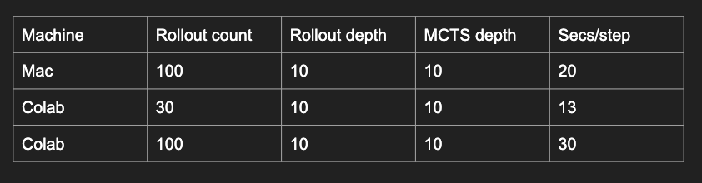
What we did last week?
Improving the AlphaGo MCTS agent
Improve by limiting the # of branches
Only search top 10 branches indicated by the policy agent

Slide 11
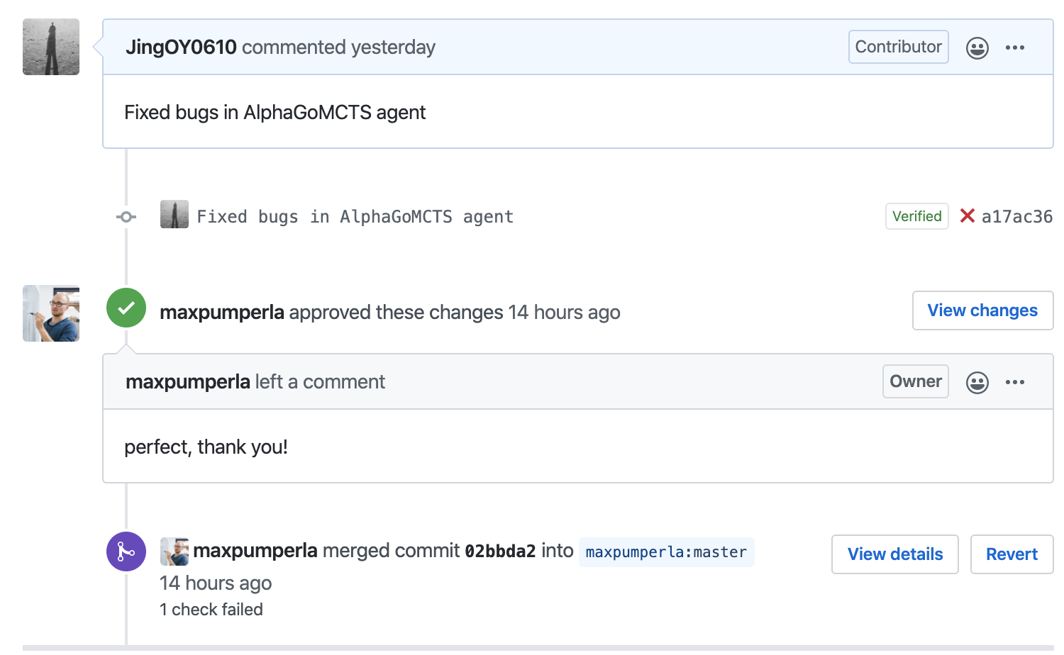
What we did last week?
Fixed some bugs in the AlphaGo agent for a Go open source project
https://github.com/maxpumperla/deep_learning_and_the_game_of_go

Slide 12
What do we plan to do next?
Code side:
Continue exploring Heuristics and training policy agent
Benchmark all our agents using GTP (Go Text Protocol)
Doc side:
Starting to build webpage/paper/presentation/demo

